Slide 3
The M in RTFM : When Code is not Enough
Developer-to-developer docs

Slide 4
Developer-to-developer docs

Slide 5
Developer-to-developer docs

Slide 6
Developer-to-developer docs
for developer as user
for developer as mainainer

Slide 7
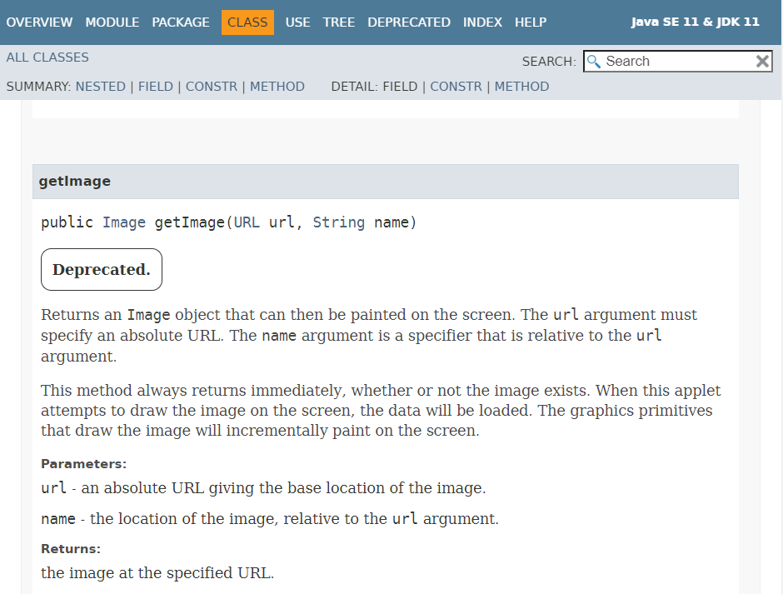
JavaDoc

Slide 8
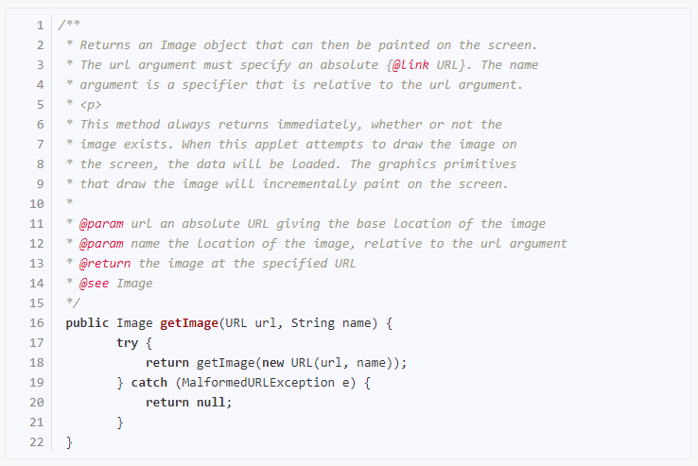
Doc comments

Slide 9
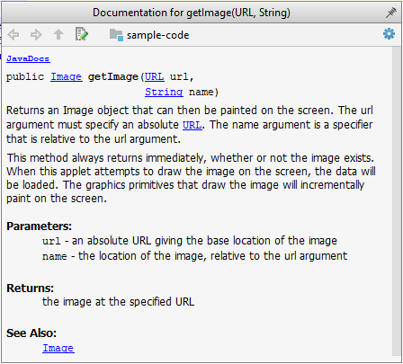

Slide 11
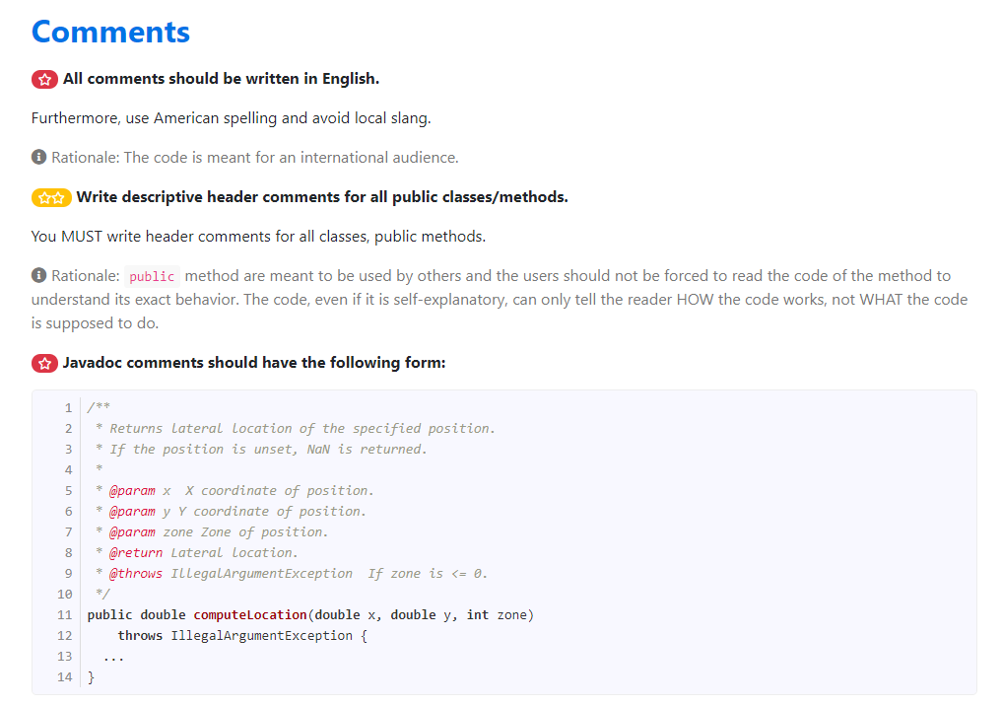
What is the subsidy if already subsidized?
Comments

Slide 12
Good comments
Is this comment OK?
✓ What?
/** Removes words not used by the compiler during… */
String trimExtraWords(String inputString){
…
start = header.trim(header.indexOf(‘k’)+2, min(footer.length()/2-2, temp++))
header.compact();
}

Slide 13
Good comments
Is this comment OK?
✓ Why?
String trimExtraWords(String inputString){
…
start = header.trim(header.indexOf(‘k’)+2, min(footer.length()/2-2, temp++))
header.compact();
}
// to remove multiple spaces

Slide 14
Good comments
Is this comment OK?
✘ How?
String trimExtraWords(String inputString){
…
start = header.trim(header.indexOf(‘k’)+2, min(footer.length()/2-2, temp++))
header.compact();
}
// first we get index of k and …

Slide 15
What is the discount if already subsidized?
int calculateDiscount() {
int discount;
if (!age) { //not over age limit
if (!sub) {
if (! notFTime) {
discount = 500; // not part time
}else {
discount = 250; // part time
}
} else {
discount = 250; //overAgeLimit
}
}else {
discount = 0; // already subsidized
}
return discount;
}

Slide 16
What is the discount if already subsidized?
int calculateDiscount() {
int discount;
if (!age) {
if (!sub) {
if (! notFTime) {
discount = 500;
}else {
discount = 250;
}
} else {
discount = 250;
}
}else {
discount = 0;
}
return discount;
}

Slide 17
What is the subsidy if already subsidized?
What is the discount if already subsidized?
int calculateDiscount(){
int discount;
if (isSenior) {
discount = 0; } else if (isAlreadySubsidized) {
discount = 250; } else if (isPartTime)
discount = 250;
} else { discount = 500;
}
return discount;
}
SELF-explanatory

Slide 18
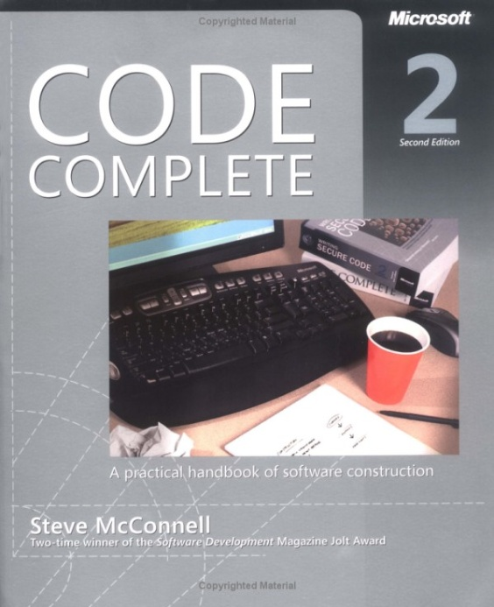
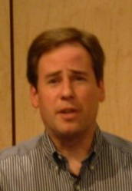
Good code is its own best documentation. As you’re about to add a comment, ask yourself, ‘How can I improve the code so that this comment isn’t needed?’ --Steve McConnell

Slide 20
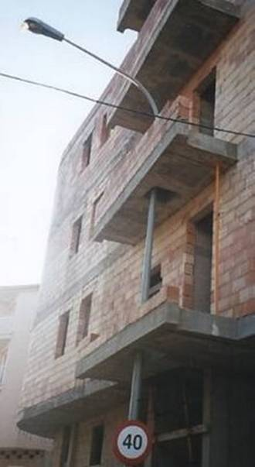
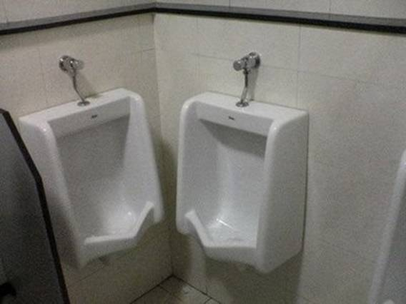

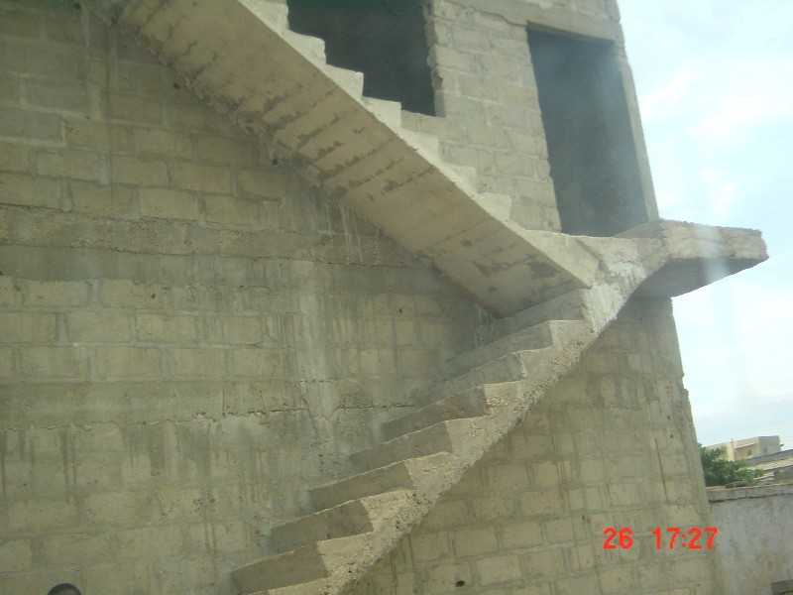

Integration
Combining parts of the software to get the whole product

Slide 21
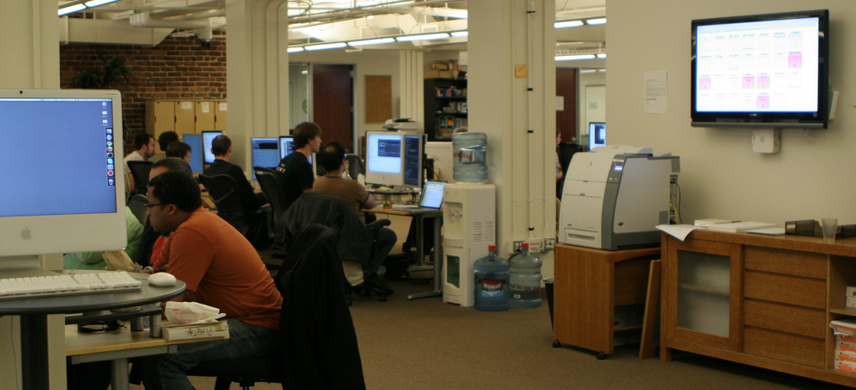
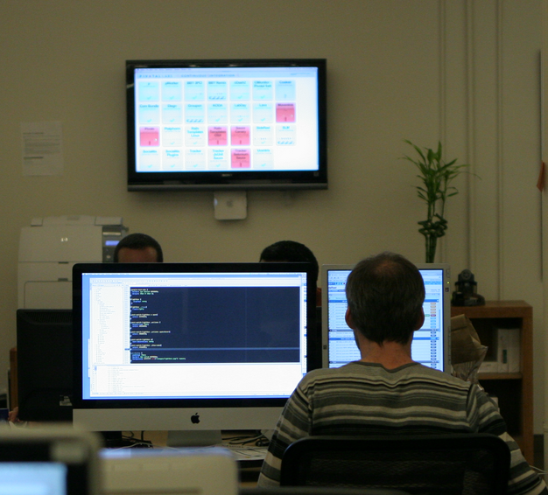
Integration
Continuous
Merging code to the shared repository frequently

Slide 22



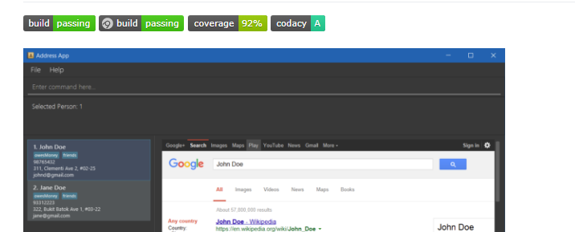
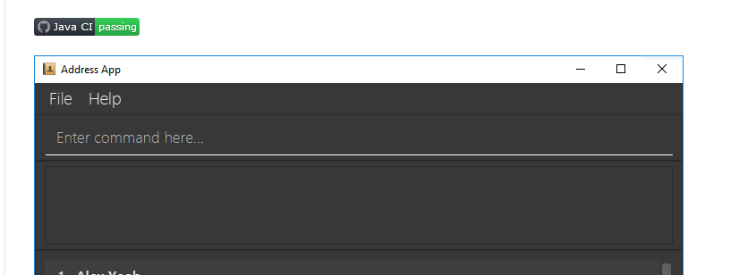
Integration
Continuous
Can use Github Actions, Travis and AppVeyor to perform Continuous Integrations
Can use Github Actions, Travis and AppVeyor to perform Continuous Integrations

Slide 23
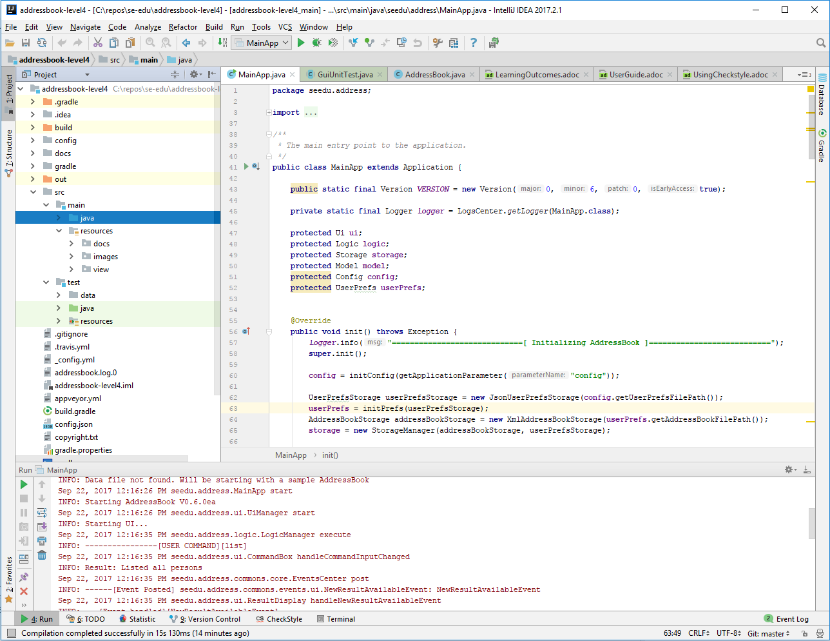
1. Do a small change + tests 2. Run tests 3. Fix any problems 4. Rinse and repeat

Slide 24
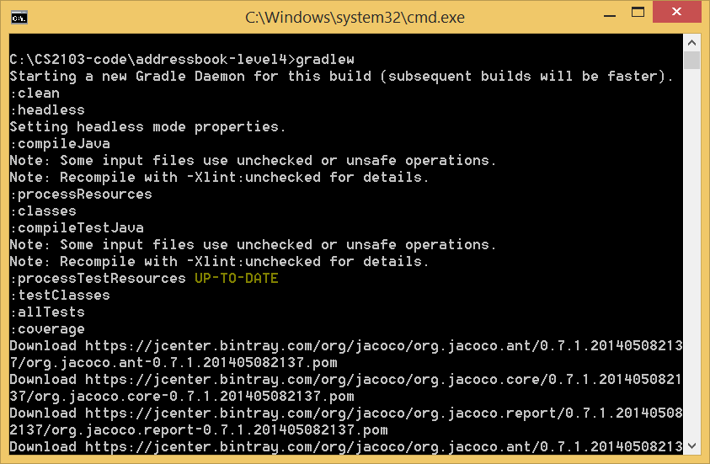

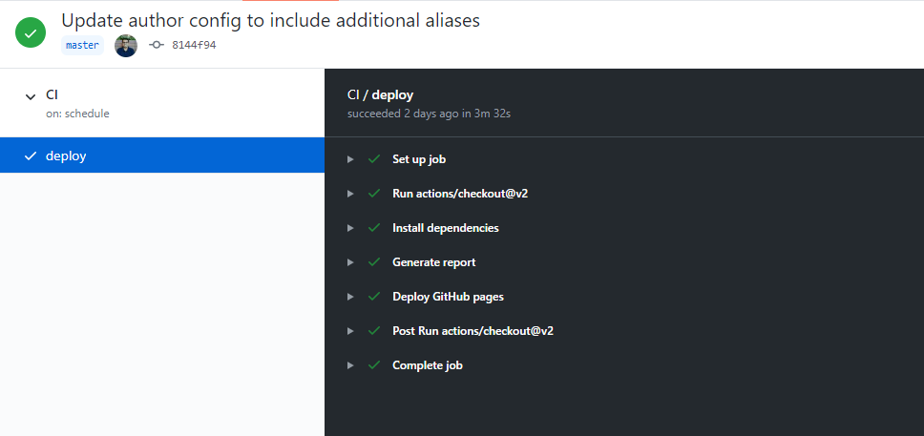
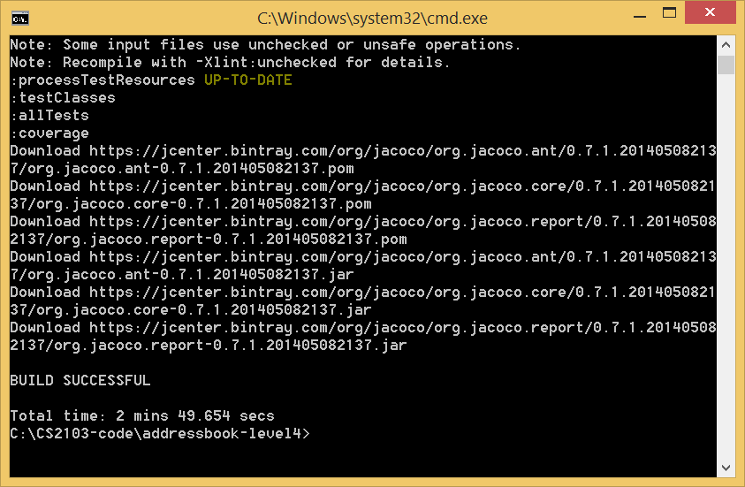
1. Do a small change + tests 2. Run tests 3. Fix any problems 4. Rinse and repeat
We use Gradle for build automation
GH Actions runs tests for the code pushed to repo

